Slide 1
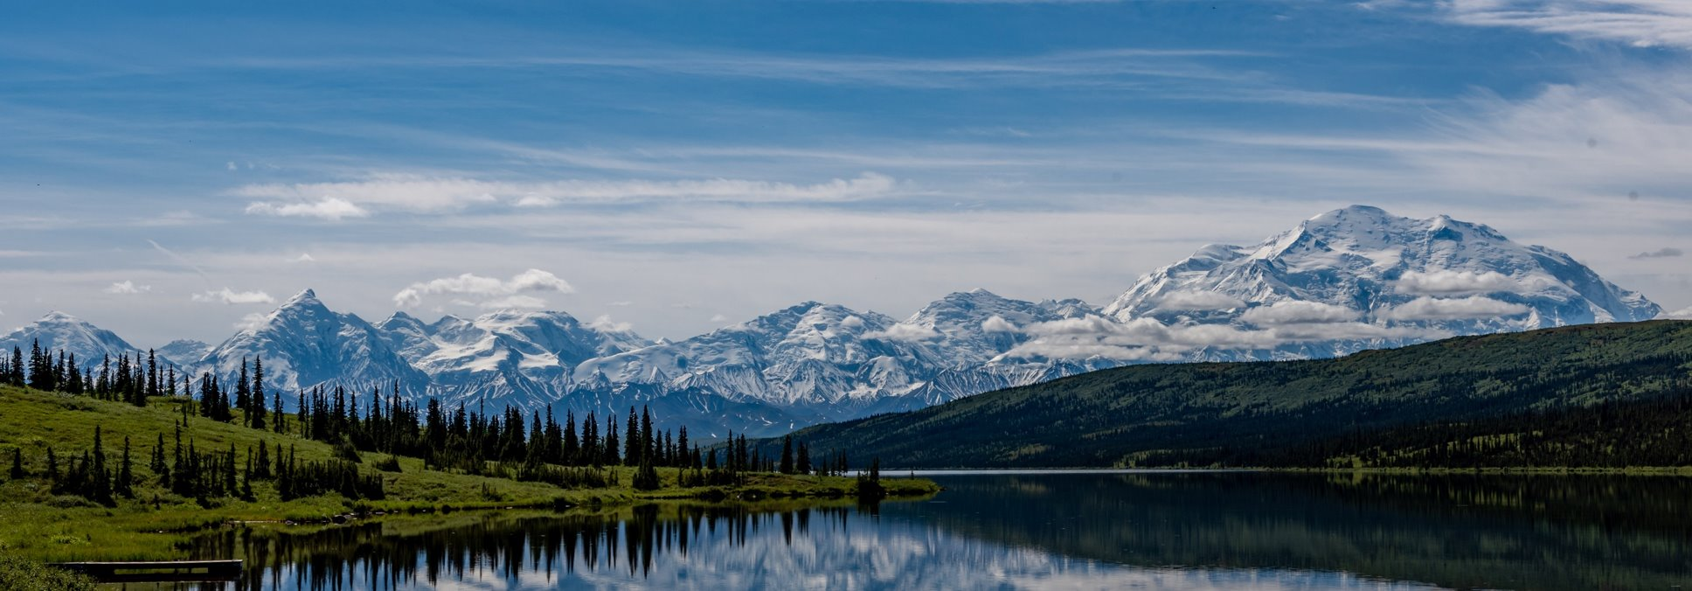
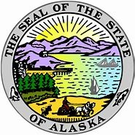
Community Development Block Grant-Mitigation Action Plan Development and Risk Assessment Overview
Public Hearing-State of Alaska
11/14/2022

Slide 2

Housekeeping
Auto-generated closed captioning is available. Click the “Live Transcription” icon.
Click the Globe/ Interpretation button to access the live Spanish Interpretation channel.
During the public comment portion if you would like to make a comment in the chat or verbally the host will unmute you.
For technical support, please chat “ICF Tech Support” or email Larisa.Crewalk@icfnext.com.

Slide 3
Community Development Block Grant-Mitigation Action Plan Development and Risk Assessment Overview
Public Hearing-State of Alaska
11/14/2022

Slide 4
Contents
Introduction and Overview
  Purpose for today’s public hearing
  CDBG-MIT Introduction and Activities
  Most Impacted and Distressed Areas
Mitigation Needs Assessment
Hazard Profiles
Critical Facilities
Proposed Action Plan Activities and Action Plan Timeline
Opportunity for Discussion and Comments
Notes:
Agenda is presented in roughly the order of the contents of the MNA within the action plan.

Slide 5
Introduction and Overview

Slide 6
Purpose of Today’s Public Hearing
The Department of Housing and Urban Development (HUD) has allocated $2,288,000 in Community Development Block Grant funds for Mitigation (CDBG-MIT) to Alaska in response to the 2018 Cook Inlet (Port McKenzie) Earthquake.
The purpose of today’s informational workshop and public hearing is to provide residents an opportunity to:
    Ask questions about the goals of the CDBG-MIT funding
    Understand the Risk Assessment methodology used to prioritize risks
    Provide comments regarding mitigation needs in your community to protect from future disaster events
    Respond to the draft Action Plan describing mitigation activities to be funded with the grant
Comments will be accepted following this presentation orally and in writing through email, postal mail, and fax.
The State has posted a draft Action Plan on its website and will continue to solicit comments through December 10, 2022 before submitting a final plan to HUD

Slide 7
What are CDBG-MIT Funds?
On January 6, 2021, HUD issued a Federal Register Notice allocating CDBG-MIT funds to Alaska
HUD previously awarded Alaska $35 million in CDBG Disaster Recovery (CDBG-DR) funds explicitly for disaster recovery efforts.
The Notice requires that all activities supported by CDBG-MIT funds must meet HUD's definition of mitigation:
        Activities that increase resilience to disasters and reduce or eliminate the long-term risk of loss of life, injury, damage to and loss of property, and suffering and hardship, by lessening the impact of future disasters
The CDBG-MIT funds represent a unique and significant opportunity to carry out strategic and high-impact activities to mitigate future disasters
At least 50% of the funds must be used in the HUD-identified Most Impacted and Distressed Area (Municipality of Anchorage) and the remaining funds may be used in the State-identified MID Area (Matanuska-Susitna and Kenai Peninsula Boroughs)
Notes:
On January 6, 2021, the US Department of Housing and Urban Development allocated $2.288,000 in Community Development Block Grant – Mitigation funds to the State of Alaska for activities that mitigate natural hazard risks to the region impacted by the 2018 Cook Inlet Earthquake disaster. HUD requires the State to use funds on activities that increase resilience to disasters and reduce or eliminate the long-term risk of loss of life, injury, damage to and loss of property, and suffering and hardship, by lessening the impact of future disasters. CDBG-MIT funds represent a unique and significant opportunity to carry out strategic and high-impact activities to mitigate future disasters. This informational workshop and public hearing will provide residents an opportunity to ask questions about the goals of the CDBG-MIT funding, understand the Risk Assessment methodology used to prioritize risks, provide comments regarding mitigation needs in your community to protect from future disaster events.

Slide 8
HUD CDBG-MIT Objectives
Support data-informed investments in high-impact projects which will reduce risks attributable to natural disasters
Place focus on repetitive loss of property and critical infrastructure
Build capacity of States and local governments to analyze disaster risks and to update hazard mitigation plans through data and meaningful community engagement
Support the adoption of policies that reflect local and regional priorities having long-lasting effects on community risk reduction
Notes:
HUD has allocated close to $20 billion in CDBG-MIT funds beginning in 2019 to states and local jurisdictions throughout the country. CDBG-MIT grants represent an effort by the Federal government to aid communities in their work to reduce risk to future disaster impacts.

Slide 9
CDBG-MIT Eligible Activities
CDBG-MIT funded activities must:
Meet the definition of mitigation as described in the Federal Register Notice
Address the current and future risks identified in the Mitigation Needs Assessment
Prioritize Low-to-Moderate Income (LMI) communities
Examples of uses are:
Resiliency Planning: Gather information on hazard risks and vulnerabilities to develop land use plans, guide capital investments, and make upgrades to mapping and data systems.
Public Infrastructure: Update and improve roads, bridges, energy grids, drainage systems and more to reduce risks of flood, earthquakes, landslides, avalanches, tsunamis, wildland fire, high winds, and extreme weather.
Mapping and Modeling: Improve modeling capacity and data sharing agreements, and perform structural risk analysis for critical facilities and comprehensive hazard mapping.
Alert Systems: Improve tsunami alert system (timeliness and maintenance).
Notes:
LMI = household income is below 80% of the Area Median Income, calculated through HUD and Census data. “The Area Median Income for Anchorage is $116,300.
The Area Median Income for the Matanuska-Susitna Borough and the Kenai Peninsula Borough is $94,800.”

Slide 10
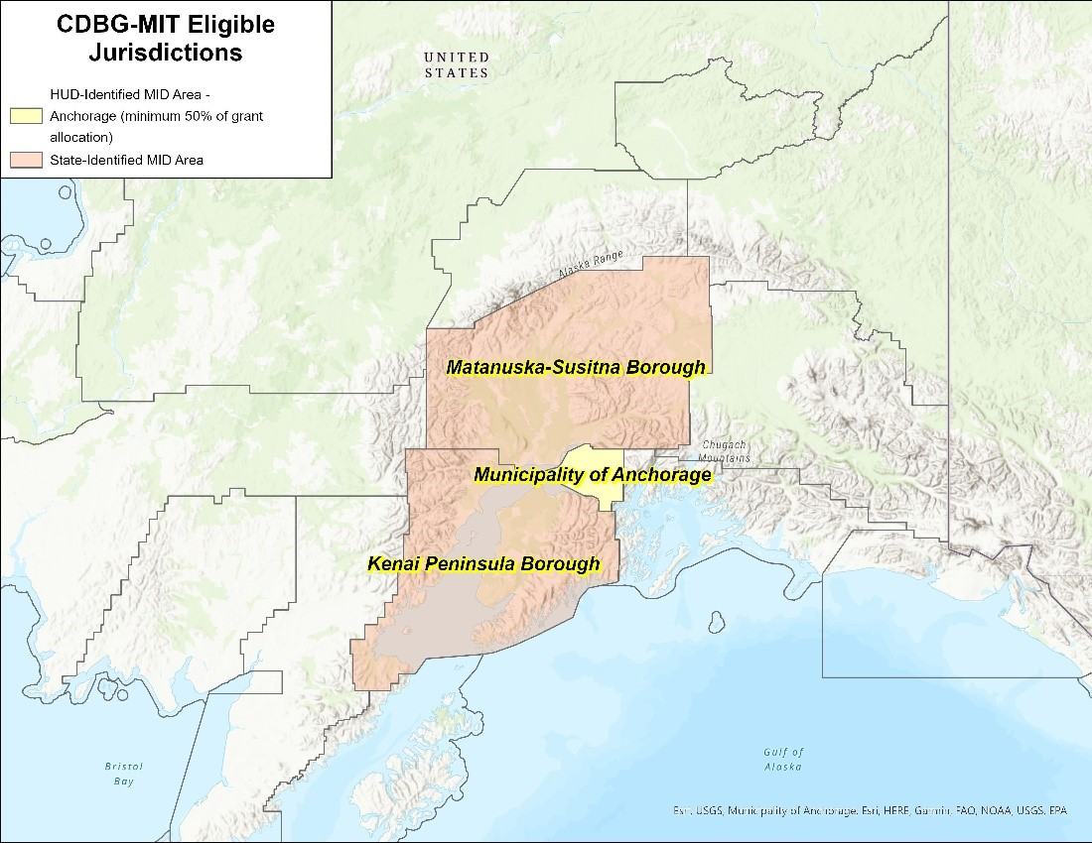
Most Impacted and Distressed Areas (MIDs)
A minimum of 50% of funds must be allocated to the HUD-identified MID area, Anchorage
The remaining funds may be allocated to Alaska's identified MID areas, Matanuska-Susitna and Kenai Peninsula Boroughs
Notes:
HUD MID: HUD uses best available disaster impact and recovery needs data to determine areas with the greatest need for federal aid.
State MID: Alaska has supplemented HUD data with local and regional data and knowledge and determined that Matanuska-Susitna Borough and the Kenai Peninsula Borough also have needs resulting from the disaster and are eligible for Federal aid.

Slide 11
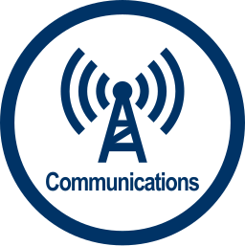


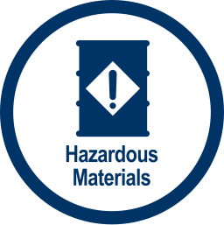



Prioritizing Community Lifelines and Critical Facilities
Infrastructure
Alerts, warnings, and messages
911 and dispatch
Responder communications
Finance
Medical Care
Patient movement
Public Health
Fatality Management
Medical supply chain
Power (Grid)
Fuel
Facilities
HAZMAT
Pollutants
Contaminants
Highway/Roadway
Mass Transit
Railway
Aviation
Maritime
Food
Water
Shelter
Agriculture
Law Enforcement/Security
Fire Service
Search and Rescue
Government Service
Community Safety
Notes:
CDBG-MIT grant guidelines require grantees to consider the mitigation needs of essential services and infrastructure systems that communities rely on to function.

Slide 12
Mitigation Needs Assessment
Notes:
Add notes –

Slide 13
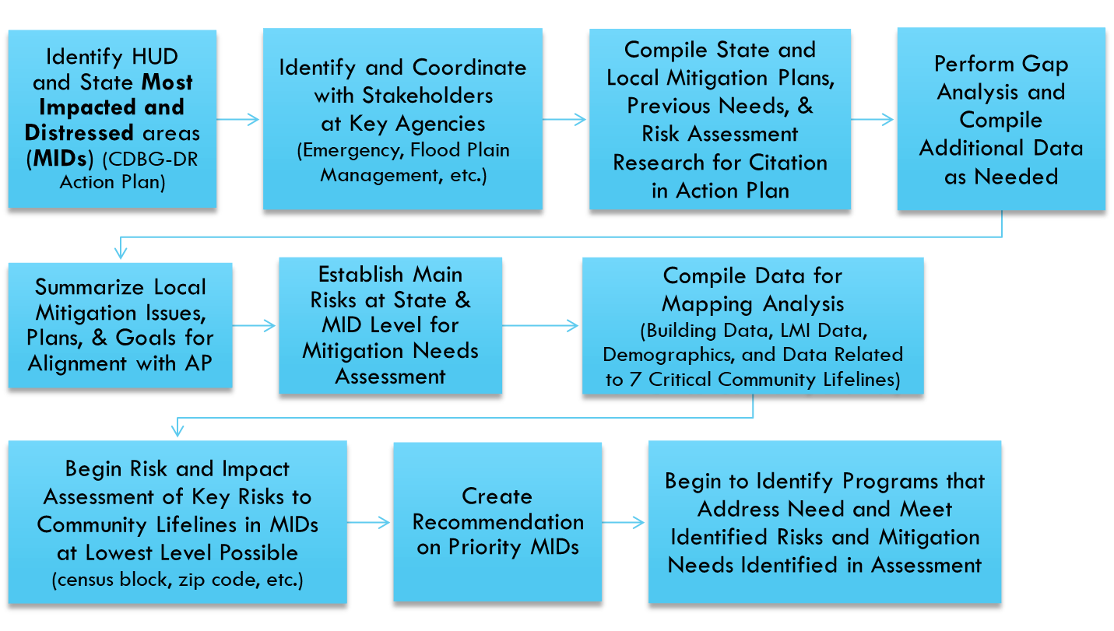
Mitigation Needs Assessment
The Mitigation Needs Assessment is a risk-based assessment that summarizes the natural threats and hazards in the Municipality of Anchorage, the Matanuska-Susitna Borough, and the Kenai Peninsula Borough. HUD identified these jurisdictions as Most Impacted and Distressed (MID) by the 2018 Cook Inlet Earthquake
Notes:
Each grantee must conduct a mitigation needs assessment of the areas impacted by a disaster, which should inform the CDBG-MIT activities that Alaska will fund.

Slide 14
Identification of Hazards
Hazards Appearance in HMPs
Analysts identified the greatest risk hazards as those natural hazards profiled in the Alaska Hazard Mitigation Plan (HMP) and were identified in each jurisdictions’ hazard mitigation plans.
Through these criteria, analysts chose and profiled eight hazards:
  Flooding
  Wildfire
  Earthquake
  Tsunamis
  Landslides (Ground Failure)
  Severe Winter Storms
  Volcanoes
  Cryosphere Hazards
Sub-hazards analyzed include Erosion, Ice/Sleet and Snowstorms, and Avalanches.
 | State | Anchorage | Matanuska-Susitna | Kenai Peninsula
Flood | x | x | x | x
Erosion | x | x | x | x
Wildfire | x | x | x | x
Severe Weather (Winter) | x | x | x | x
Earthquake | x | x | x | x
Tsunamis | x |  |  | x
Volcanoes | x |  | x | x
Avalanches |  | x |  | x
Cryosphere | x |  | x
Landslide | x | x |  | x
Notes:
While the MNA profiles 8 hazards, for the sake of this presentation we chose four to highlight:
Flooding - due to its likelihood of occurrence and that it is one of the most costly hazards,
Earthquakes - due to the context of this Action Plan, severity and frequency,
Tsunamis - as requested by the client and opportunities for mitigation and lastly,
Landslides (Ground Failure) and Avalanches - due to their threat to human life.
Alignment amongst all HMPs was an important consideration for choosing these four hazards.

Slide 15
Prioritizing Lifelines and Critical Facilities
Community Priorities
Transportation is a key priority that is under threat from a number of natural hazards across multiple hazard mitigation plans. It is important to protect given the growth of the state and to provide quick response and evacuation.
Schools, libraries, and community centers are highly valued across all HMPs. They also serve as places of shelter and recovery for communities during disasters.
Recommendations
Ensure that critical facilities (hospitals, utilities, municipal buildings) have adequate backups.
Implement local planning efforts to ensure that critical facility staff have the knowledge and means to operate when the facility is under threat.
Conduct studies and modeling prioritizing vulnerabilities to critical facilities.
Lifeline Priorities in HMPs
 | State | Anchorage | Matanuska-Susitna | Kenai Peninsula
Safety & Security | x | x | x | x
Food, Water, Shelter | x | x | x | x
Health and Medical | x | x |  | x
Energy | x | x | x | x
Communications | x | x | x | x
Transportation | x | x | x | x
Hazardous Material | x
Notes:
This matrix captures each HMPs reference to FEMA’s community lifelines. Listed to the left are the 7 community lifelines created by FEMA: Safety & Security, Food, Water, Shelter, Health and Medical, Energy, Communications, Transportation, and Hazardous Material. FEMA’s community lifelines ensures that all aspects of a community are considered when evaluating hazards and facilities that have social, economic, and cultural value for a community.
Transportation is an important lifeline identified in all HMPs. Roads as well as infrastructure related facilities like ports and railroads have been identified as vulnerable by local and state HMPs, especially to hazards like flooding, earthquakes, and tsunamis.
Schools are also an important lifeline mentioned in all HMPs as well as in public comments. Schools are important part of communities life, and during disasters they often serve as shelters or places where communities can gather and gain access to resources and information.
Extensive studies and plans need to be developed for these critical yet vulnerable assets that provide economic, social, and cultural value to communities in order to guide mitigation investments.

Slide 16
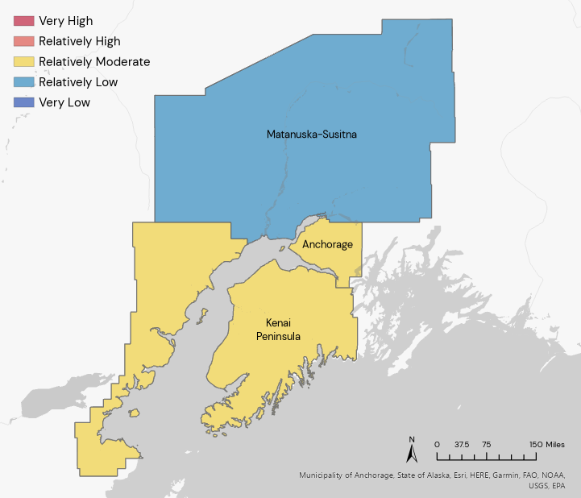
FEMA National Risk Index
(0-100)
Municipality of Anchorage – 17
  Avalanche– 37
  Earthquake – 18
  Winter Weather – 8
  * Higher risk than 89% of US counties
Kenai Peninsula Borough - 14
  Avalanche– 60
  Volcanic Activity – 55
  Tsunami – 18
  * Higher risk than 81% of US counties
Matanuska-Susitna Borough - 10
  Avalanche– 38
  Earthquake – 10
  Riverine Flooding – 4
  * Higher risk than 54% of US counties
16
Notes:
FEMA’s National Risk Index is a tool that generate composite risk scores for communities across the US. The Risk Index uses available source data for natural hazard and community risk factors to develop scores between 0 and 100 to help illustrate the relative risk for 18 natural hazards.
The score uses Expected Losses from disasters, Social Vulnerability, and Community Capacity to create a standard score.
The above slide shows the risk index for the top three hazards in each jurisdiction.
The numbers in this presentation are rounded for clarity
It is a useful tool to illustrate comparative, combined risk to natural hazards. However, it is notable that Alaska doesn’t receive risk scores for some hazards due to insufficient data. (ex. Coastal inundation, land slides)
All boroughs rank higher in risk than the Alaska overall average of 6.14. Kenai Peninsula Borough and the Municipality of Anchorage rank above the national average of 10.60. Notably, the Municipality of Anchorage has the highest NRI in the state and only 11% of counties nationally have higher risk composite scores.

Slide 17
Mitigation Needs Identified in Hazard Analysis with Example Activities
Planning & Building Codes
Structural Interventions
Alert Systems
Improve tsunami alert system (timeliness and maintenance)
Implement new zoning laws & adopt higher planning standards
Have local communities adopt most recent International Building Code (IBC) standards for future construction
Install seismic retrofits
Relocate vulnerable structures out of hazard prone areas
Install combined heat and power systems at critical facilities
Capacity Building
Mapping & Modeling
Support vulnerable communities to participate in NOAA Tsunami Readiness Program
Provide capacity for local communities to conduct analyses for certification processes and local planning efforts
Improve modeling capacity and data sharing agreements
Perform seismic and structural analysis for critical facilities
Conduct comprehensive flood mapping
Notes:
Through the needs assessment, we have identified types of mitigation activities that can be funded with the grant. In coordination with the state and jurisdictions, will decide on how the funding will be used and publish a draft Action Plan that communicates the chosen activities for public comment.

Slide 18
Proposed Action Plan Activities and Action Plan Timeline

Slide 19
Proposed CDBG-MIT Action Plan Activity Budget

Slide 20
CDBG-MIT Activity: National Spatial Reference System Transition
Activity Summary Funds will be used to support the modernization of Anchorage geospatial benchmarks to align it with the National Spatial Reference System. The NSRS conversion will support accurate flood risk mapping throughout Anchorage, enabling FEMA to update outdated flood plain maps. New maps will guide investment in infrastructure and housing, reducing hazard risk to people and property across the area.
Total Budget $1,086,800
Service Area Municipality of Anchorage
Hazards Addressed Sea level rise, flood, high surf/storm surge/coastal flooding, tsunami
Beneficiaries All residents in the Municipality of Anchorage

Slide 21
CDBG-MIT Activity: Kenai Peninsula Tsunami Alert System
Activity Summary Funds will be used to install All Hazard Alert Broadcast System Sirens intended for coastal tsunami warnings, as well as other hazards, including floods, windstorms, and volcanic activity. The Kenai Peninsula Borough intends to expand the existing sirens to Kachemak Selo resulting from the updated 2019 Tsunami Inundation Maps, which indicate this area is in the impact zone and should have sirens. The program is also investing in sirens in the following communities: Homer, Seward, Nanwalek, Port Graham, and Seldovia.
Total Budget $543,400
Service Area Kachekmak Selo, Kenai Peninsula Borough
Hazards Addressed Tsunami, flooding, high surf/storm surge/coastal flooding, high winds, sea level rise
Beneficiaries All residents of Kachekmak Selo, Kenai Peninsula Borough

Slide 22
CDBG-MIT Activity: Matanuska-Susitna Home Flood Mitigation Program
Activity Summary The Matanuska-Susitna Borough (MSB) Home Flood Mitigation Program is a competitive funding program with funding available for three types of mitigation activities targeting homeowner-occupied housing units or vacant structures located within the Matanuska-Susitna Borough (MSB) and including properties within the City of Houston. The mitigation measures may include home elevation, home floodproofing, or home buyout and relocation activities.
Total Budget $543,400
Service Area Matanuska-Susitna Borough
Hazards Addressed Flooding, ice jams, high winds
Beneficiaries Homeowners within Matanuska-Susitna Borough

Slide 23
Public Engagement Schedule for Pre-Action Plan Comments
People who would like to provide public comments will each be given time to speak during the hearing.
Those wishing to speak are encouraged to bring a written copy of their comments.
Written public comments may also be submitted by:
Webform:
    Spanish: https://app.smartsheet.com/b/form/0c0f19163bc5411295b1b3c67ac728f8
    English: https://app.smartsheet.com/b/form/4aa1215029574778a0939a5d8476fd98
Email: ced.cra.cdbgmit@alaska.gov
Postage Mail:
  State of Alaska
    Department of Commerce, Community, and Economic Development
    550 W. 7th Ave. Ste . 1650, Anchorage, AK 99501
FAX: 907-269-4563
  *Label or Note your comment is for Alaska CDBG-MIT
For additional information, please visit the Alaska Department of Commerce, Community, and Economic Development
  https://commerce.alaska.gov/web/dcra/GrantsSection/CDBG-MIT.aspx

Slide 24

Share your public comment verbally.
Please add your name in the chat. We will call on your and unmute you.
If you speak Spanish, please speak in Spanish and it will be interpreted to the panelist. Please wait for a reply in Spanish.
Please list questions in the chat. They will be used to develop a FAQ for the website.

Slide 25
Comment Period
Notes:
We will now provide the audience an opportunity to submit comments on the use of CDBG-MIT funds.

